Slide 1
Large Language Models
Prof John Weirstrass MUTEBA MWAMBA

Slide 2
Pretrained Models

Slide 3
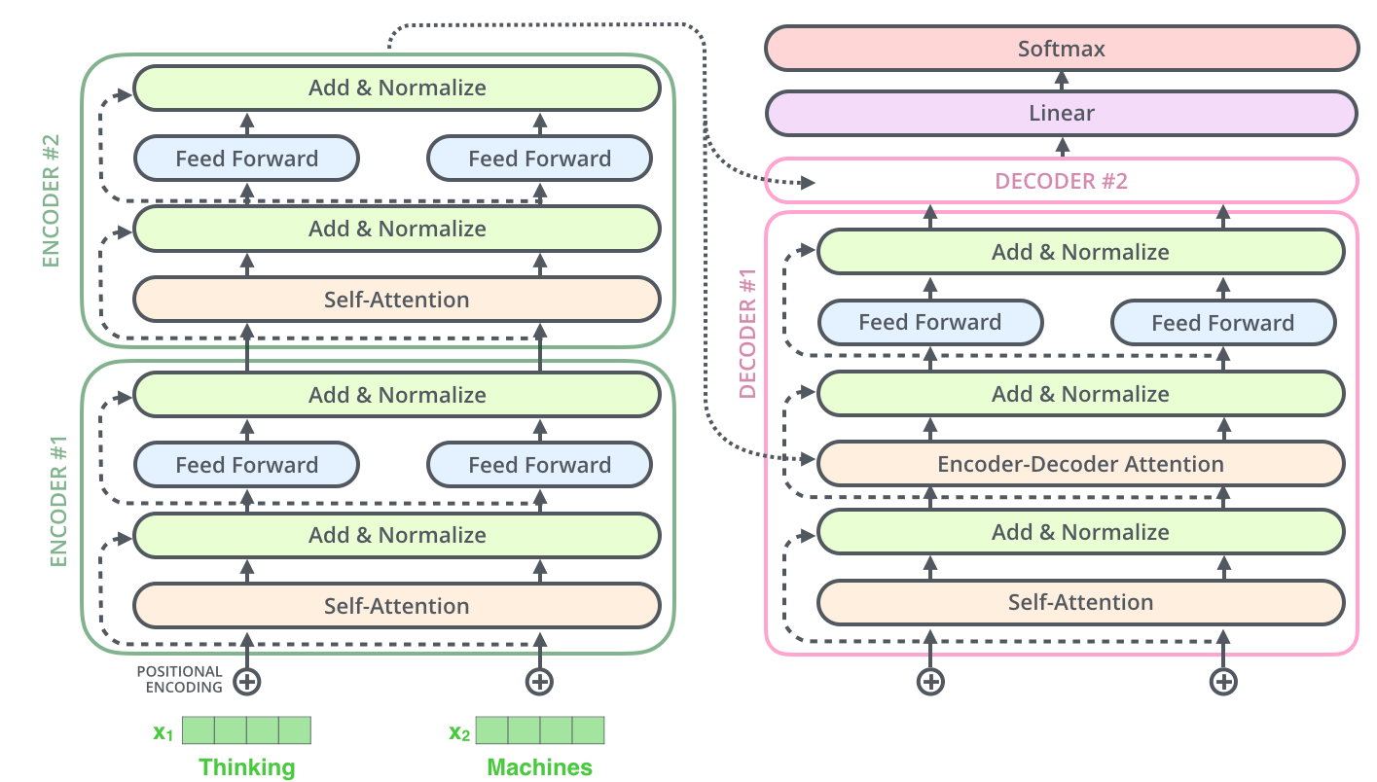
Transformer model as an Encoder-Decoder Model
Encoder (e.g., BERT)
Decoder (e.g., GPT)

Slide 4
GPT and BERT Models
A transformer uses an encoder stack to model input, and uses decoder stack to model output (using input information from encoder side)
If we do not have input, we just want to model the “next word”, we can get rid of the encoder side of a transformer and output “next word” one by one. This gives us GPT model
If we are only interested in training a language model for the input for some other tasks, then we do not need the decoder of the transformer, that gives us BERT model

Slide 5
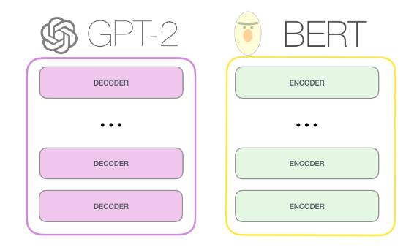
GPT and BERT Models
03

Slide 6
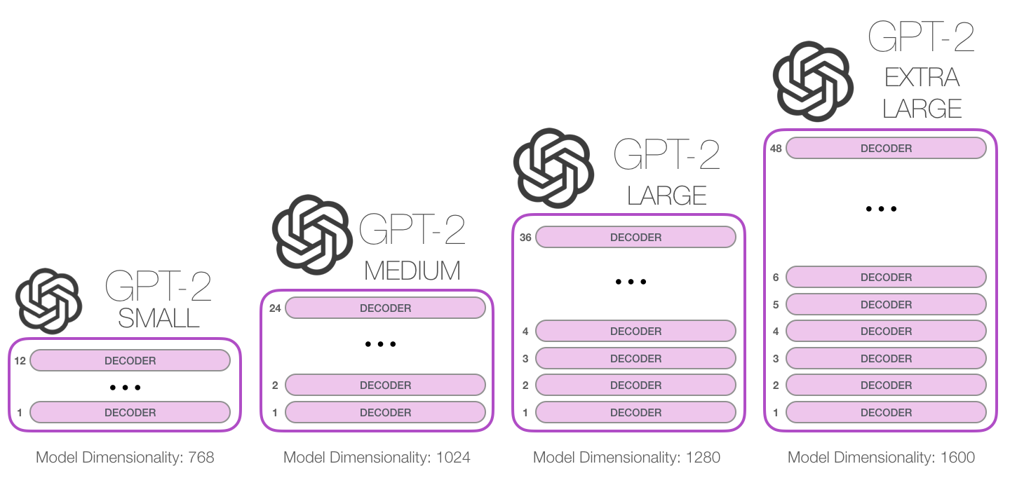
GPT released June 2018
GPT-2 released Nov. 2019 with 1.5B parameters
GPT-3 released in 2020 with 175B parameters
03
117M parameters
345M
762M
1542M

Slide 7
Pretrained Models
Unsupervised pretraining over a very large dataset of general text
Followed by supervised fine-tuning over a focused data set of inputs and outputs for a particular task
Tasks for pretraining and fine-tuning commonly include:
language modeling
next-sentence prediction (aka completion)
question answering
reading comprehension
sentiment analysis
paraphrasing
Chat,

Slide 8
Pretrained models
Since training a model requires huge datasets of text and significant computation, researchers often use common pretrained models
Examples (circa December 2021) include
Google’s BERT model
Huggingface’s various Transformer models
(https://huggingface.co/models )
OpenAI’s and GPT-3 models
(https://platform.openai.com/examples)

Slide 9
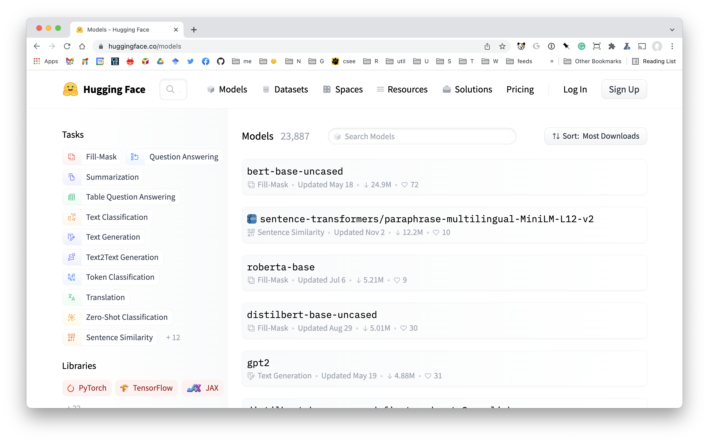
Hugggingface Models

Slide 10
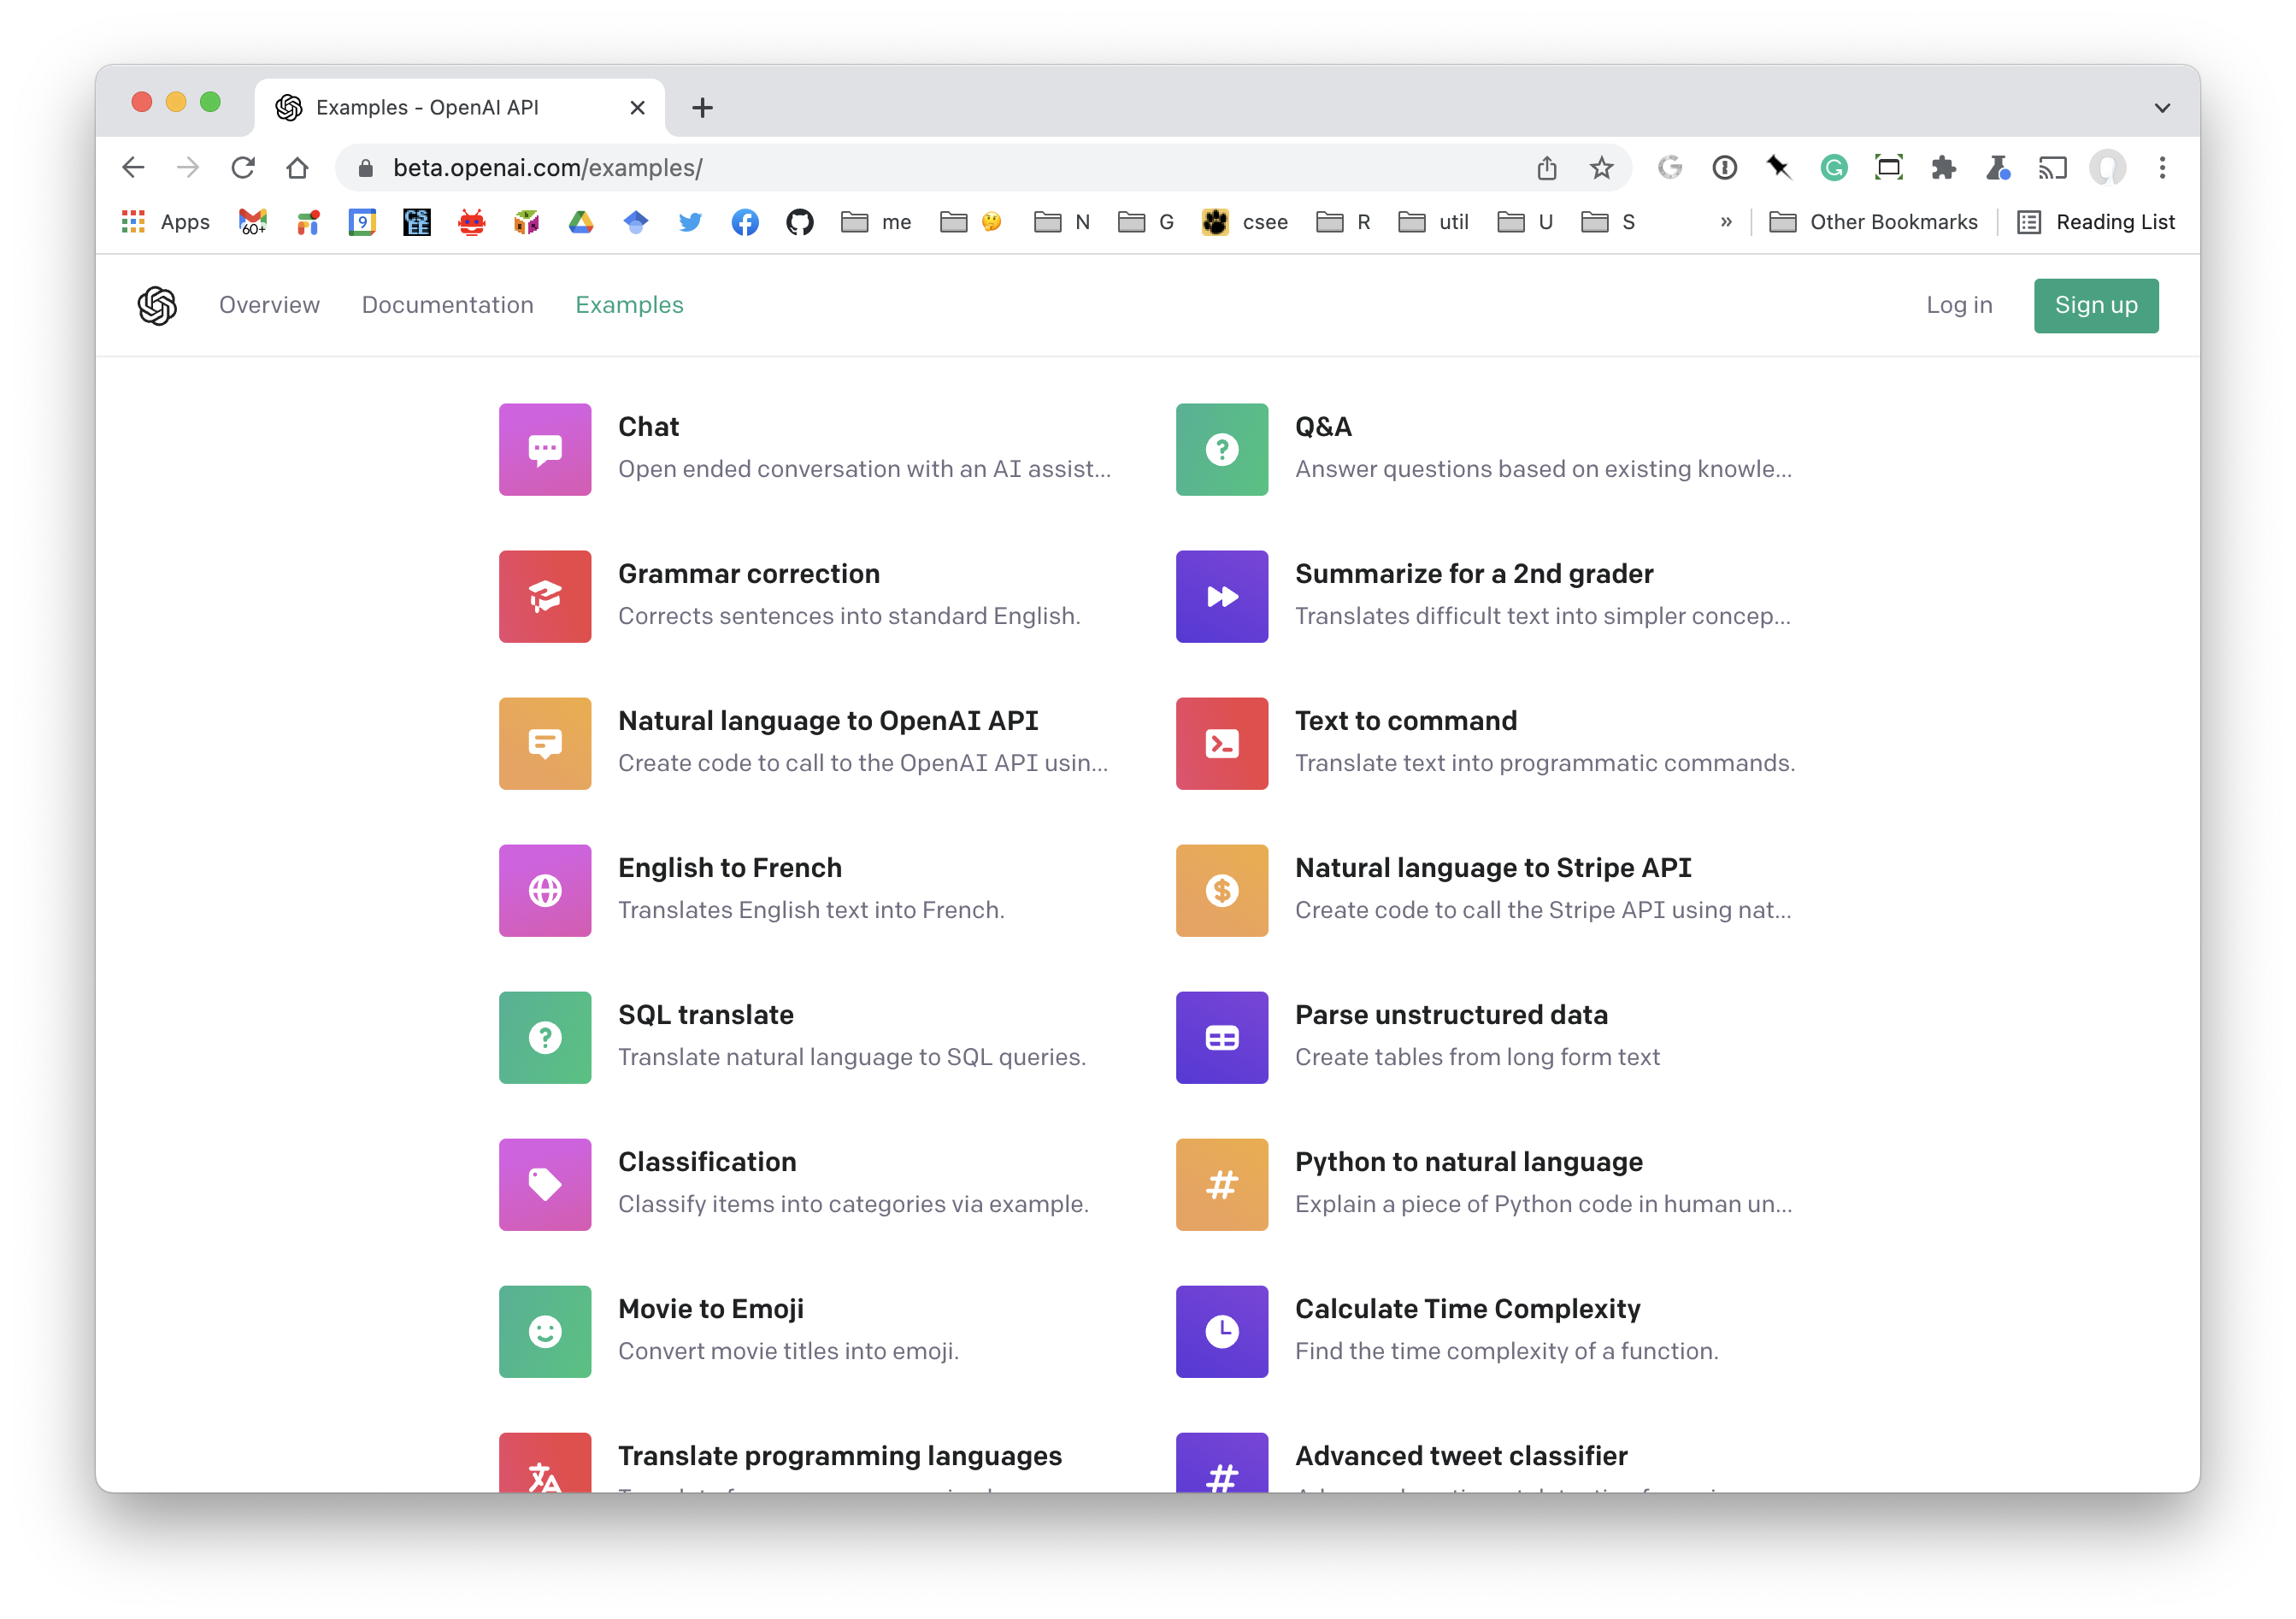
OpenAI Application Examples

